Slide 1


Slide 2
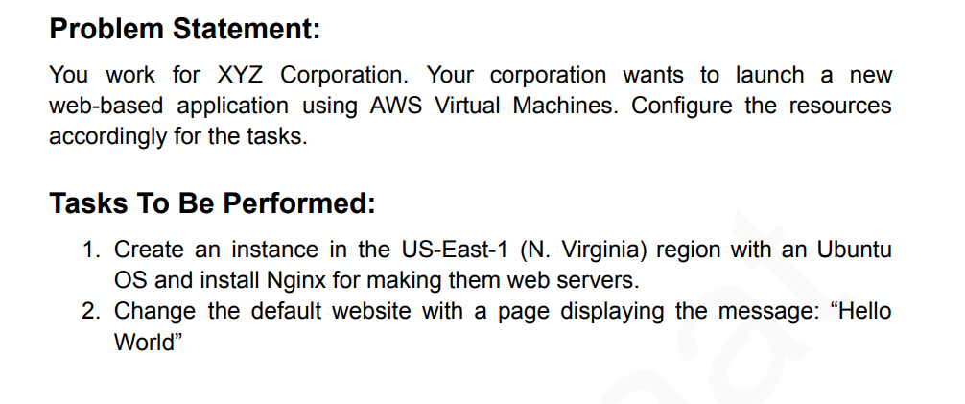

Slide 3
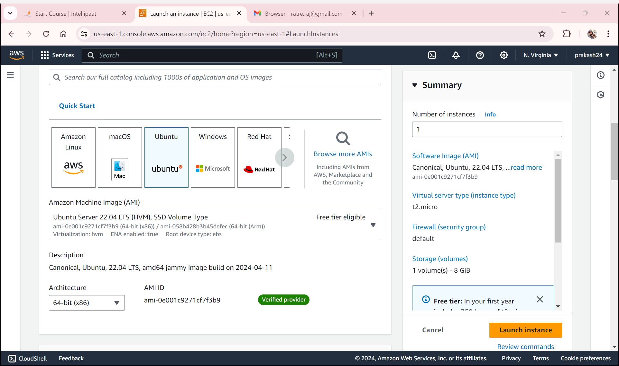
Launching ec2 instance in US-East-1 (N. Virginia) with Ubuntu

Slide 4
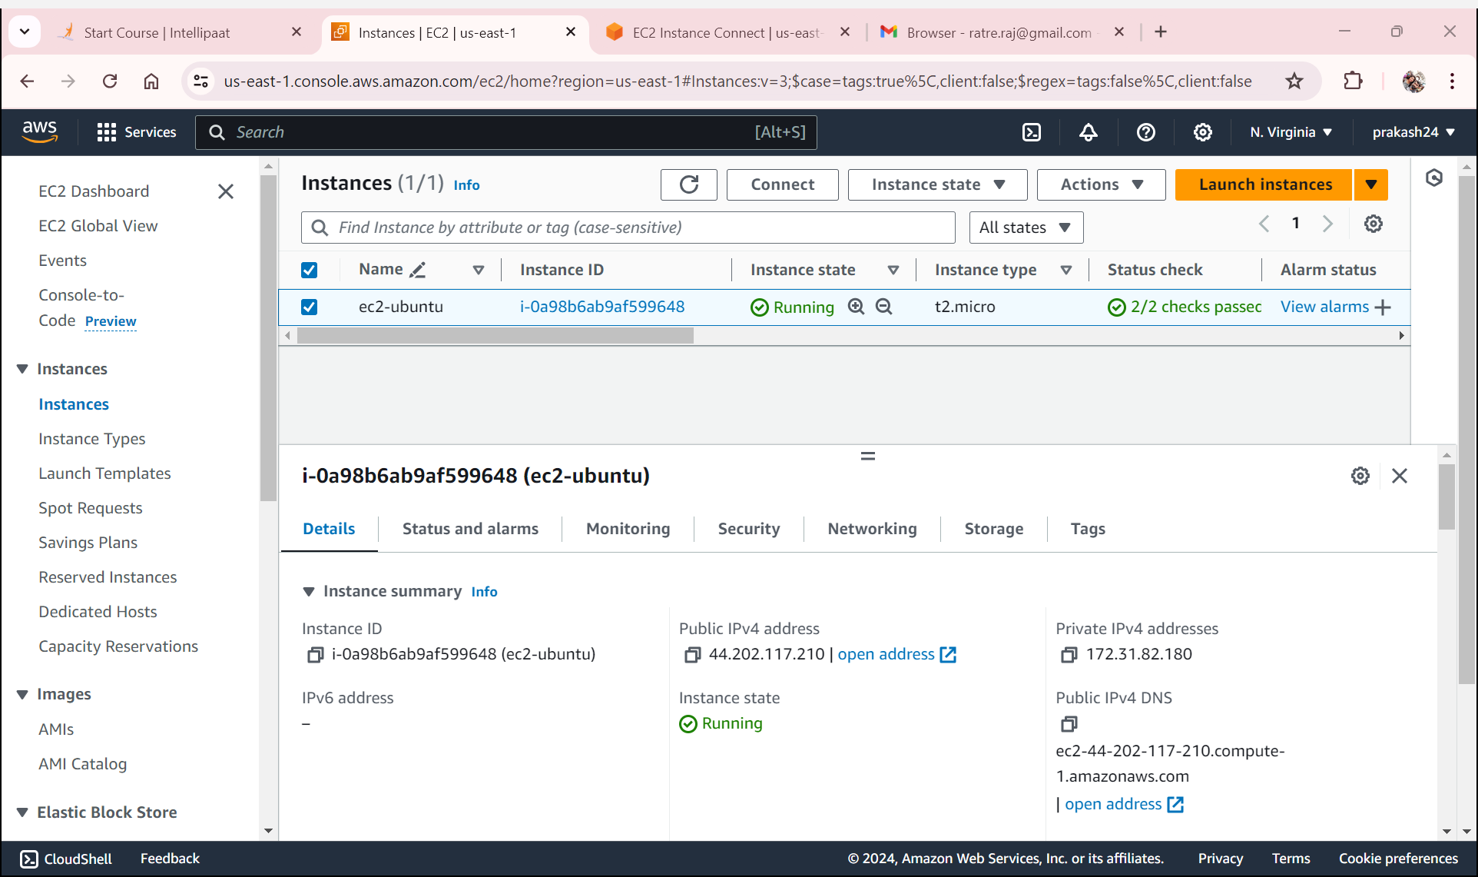
ec2 instance is in running status

Slide 5
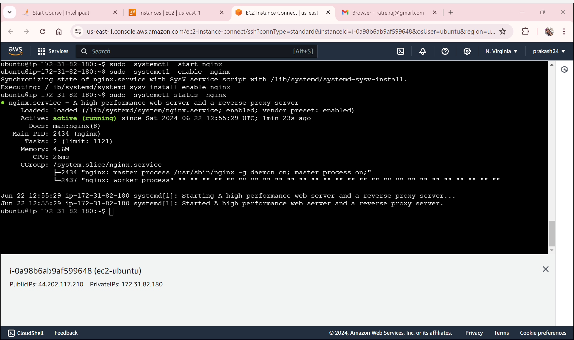
Nginx server is install in ubuntu
sudo apt update
sudo apt install nginx
sudo systemctl start nginx
sudo systemctl enable nginx

Slide 6
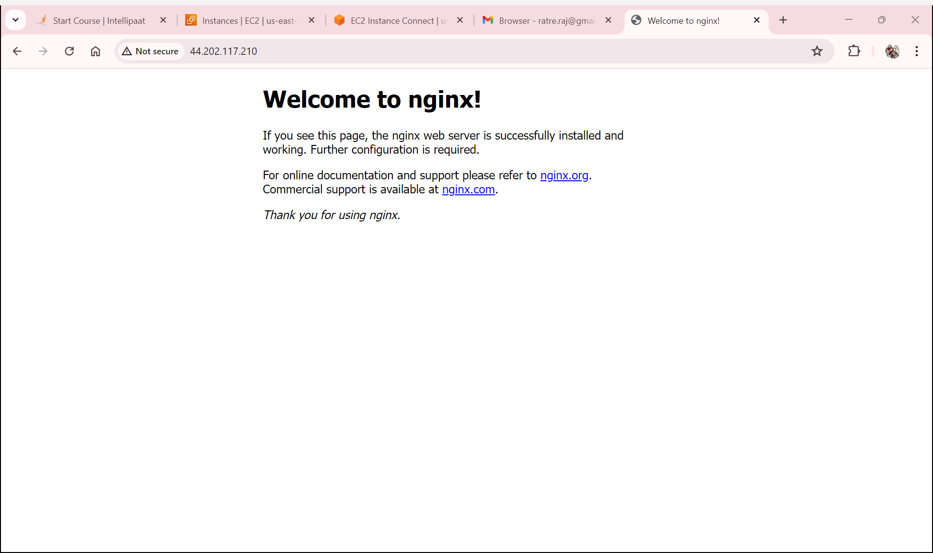
Test page of nginx server

Slide 7
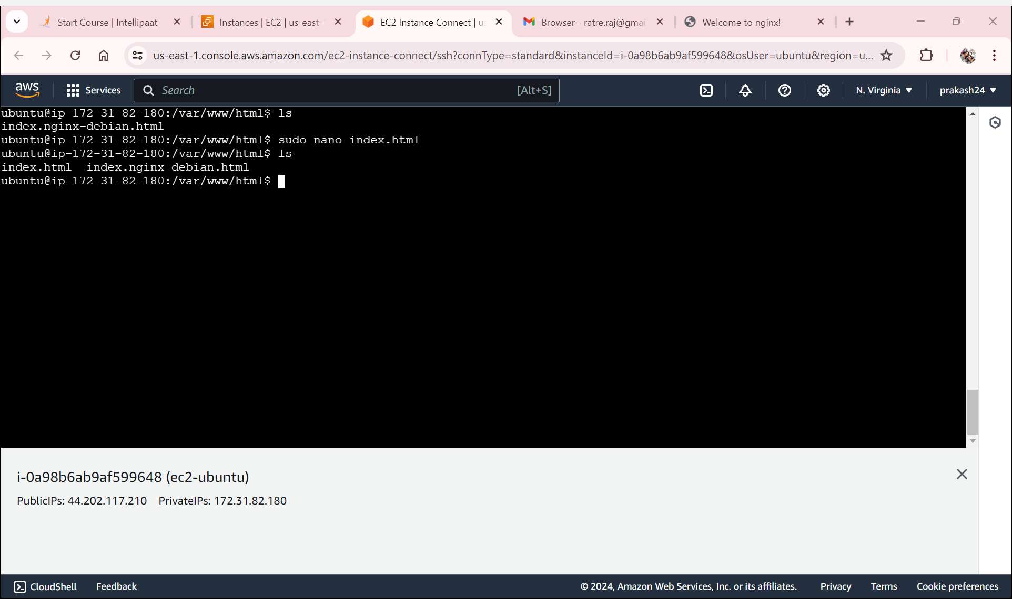
Added a index.html page

Slide 8
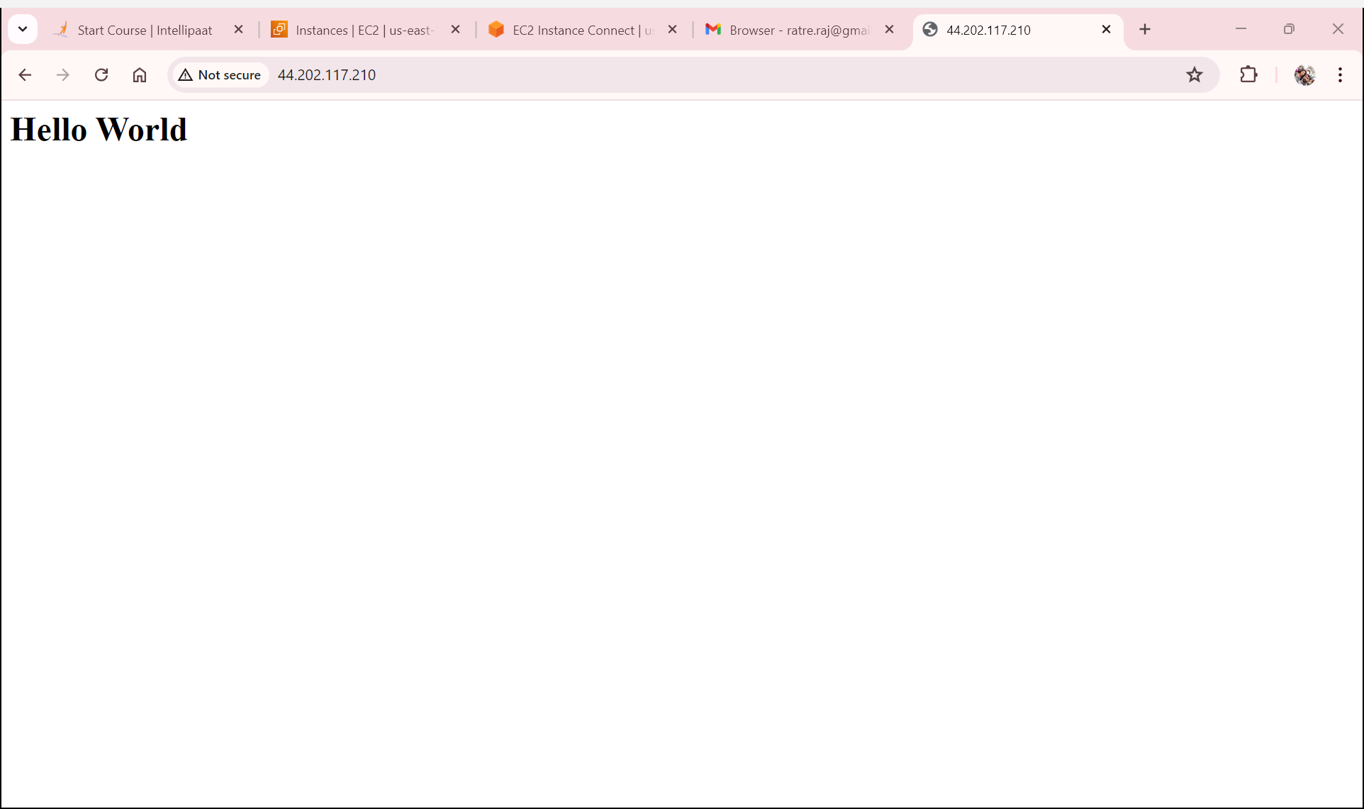
page displaying the message: “Hello World”

Slide 9


Slide 10
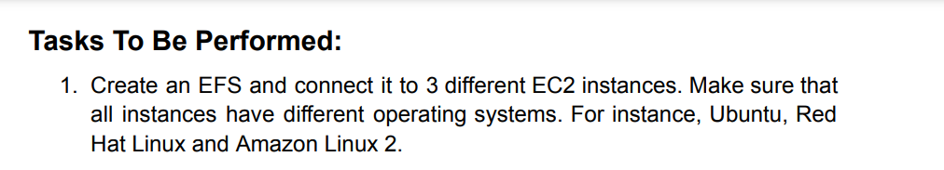

Slide 11
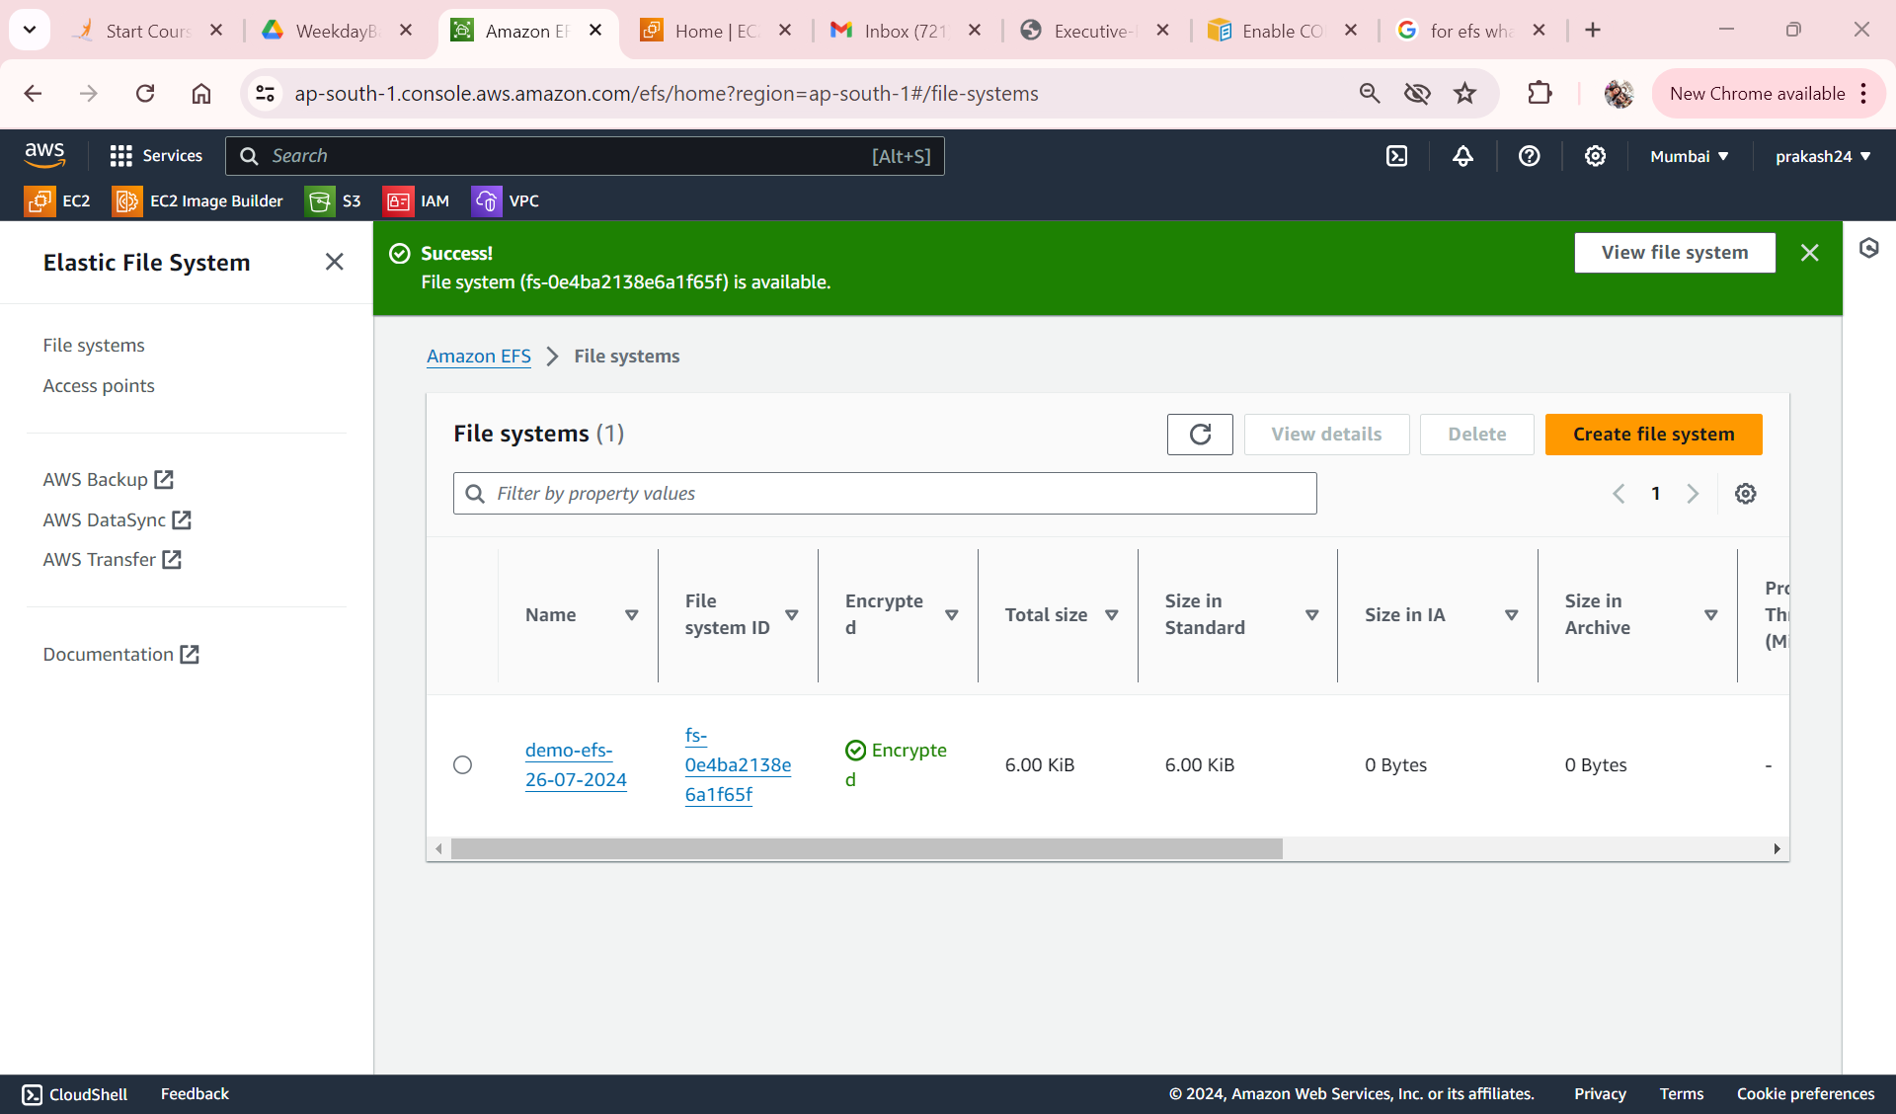
EFS Created in default VPC

Slide 12
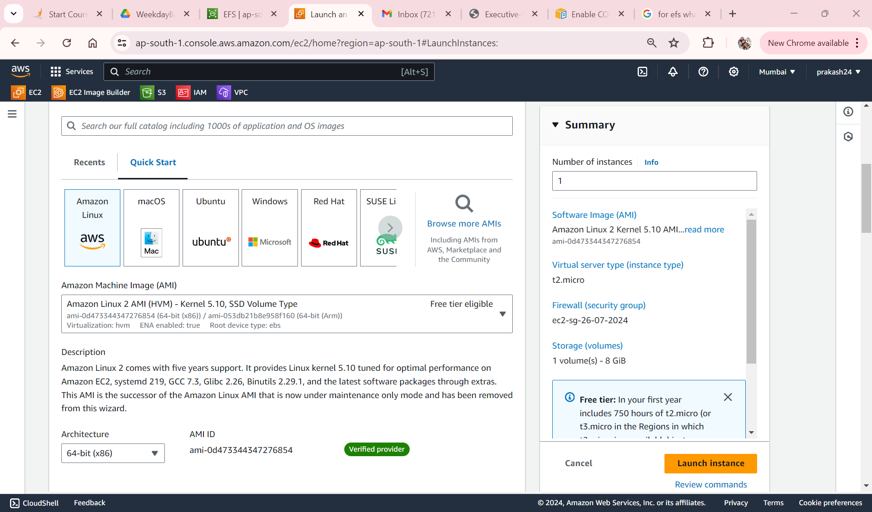
Select AMI for EC2

Slide 13
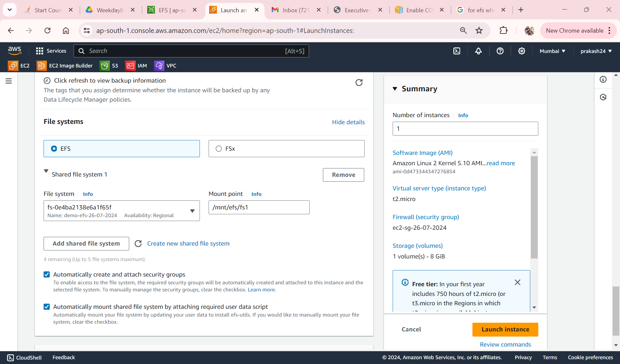
Attaching EFS to ec2 while creating

Slide 14
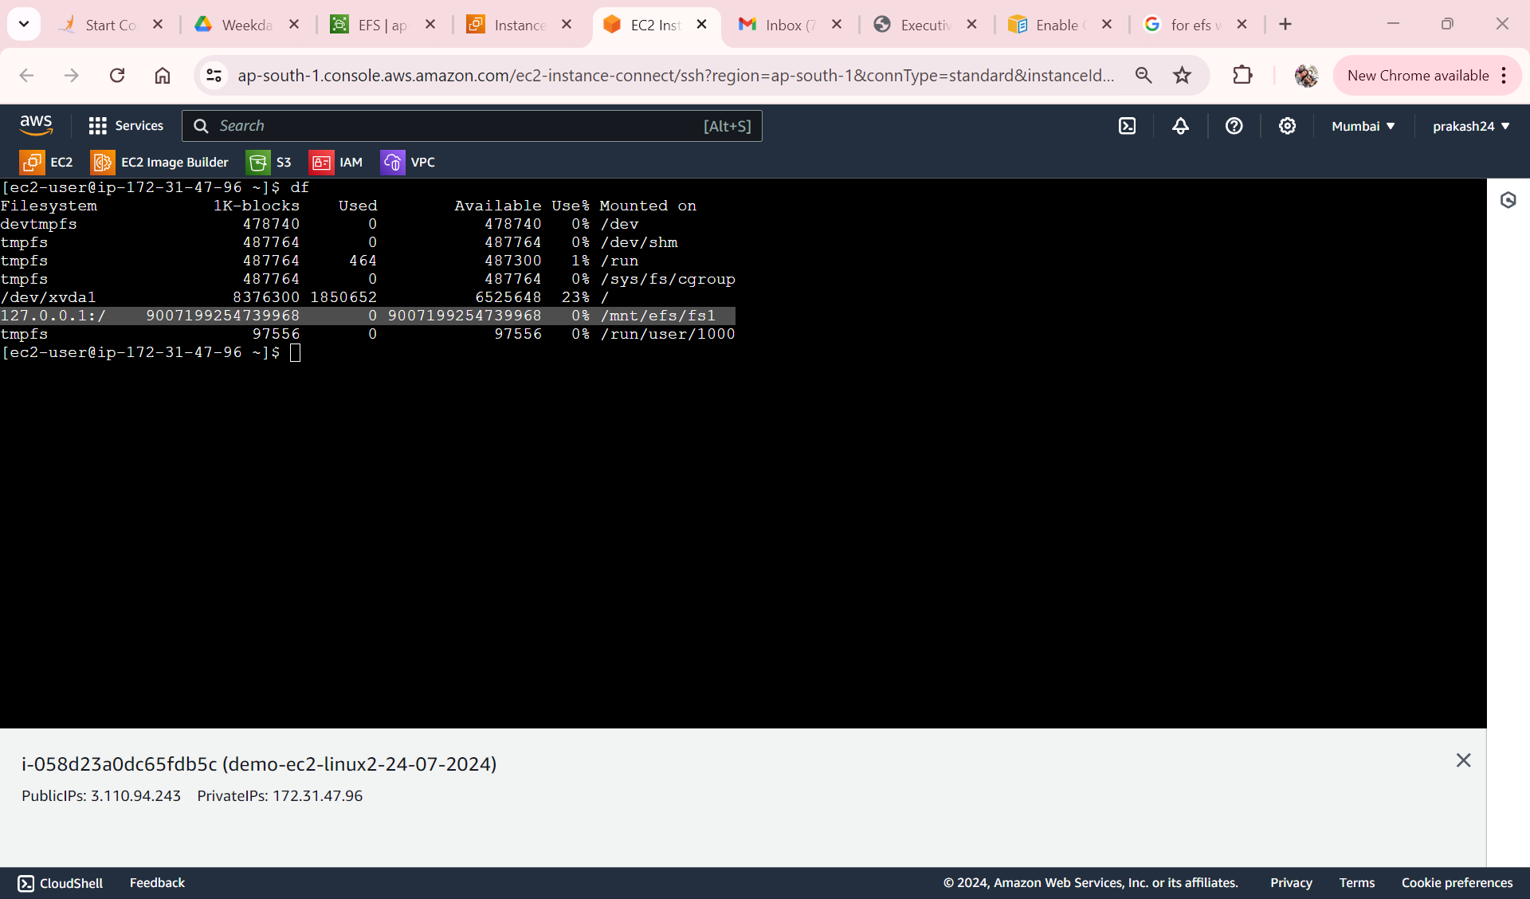
EFS is mounted in ec2 linux2

Slide 15
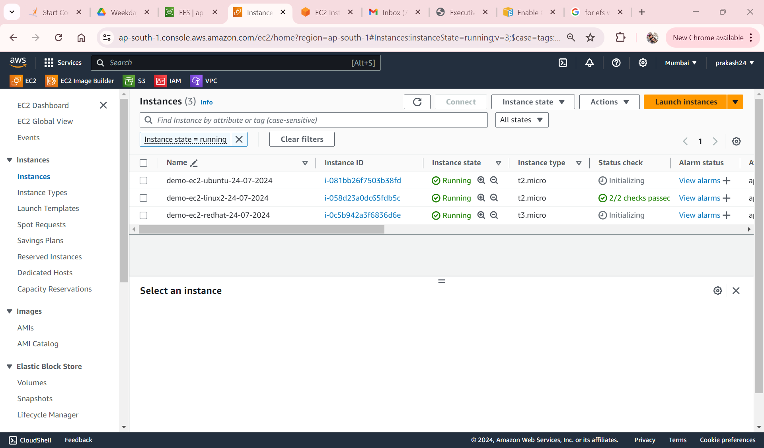
3 different ec2 linux2,Redhat, Ubuntu

Slide 16
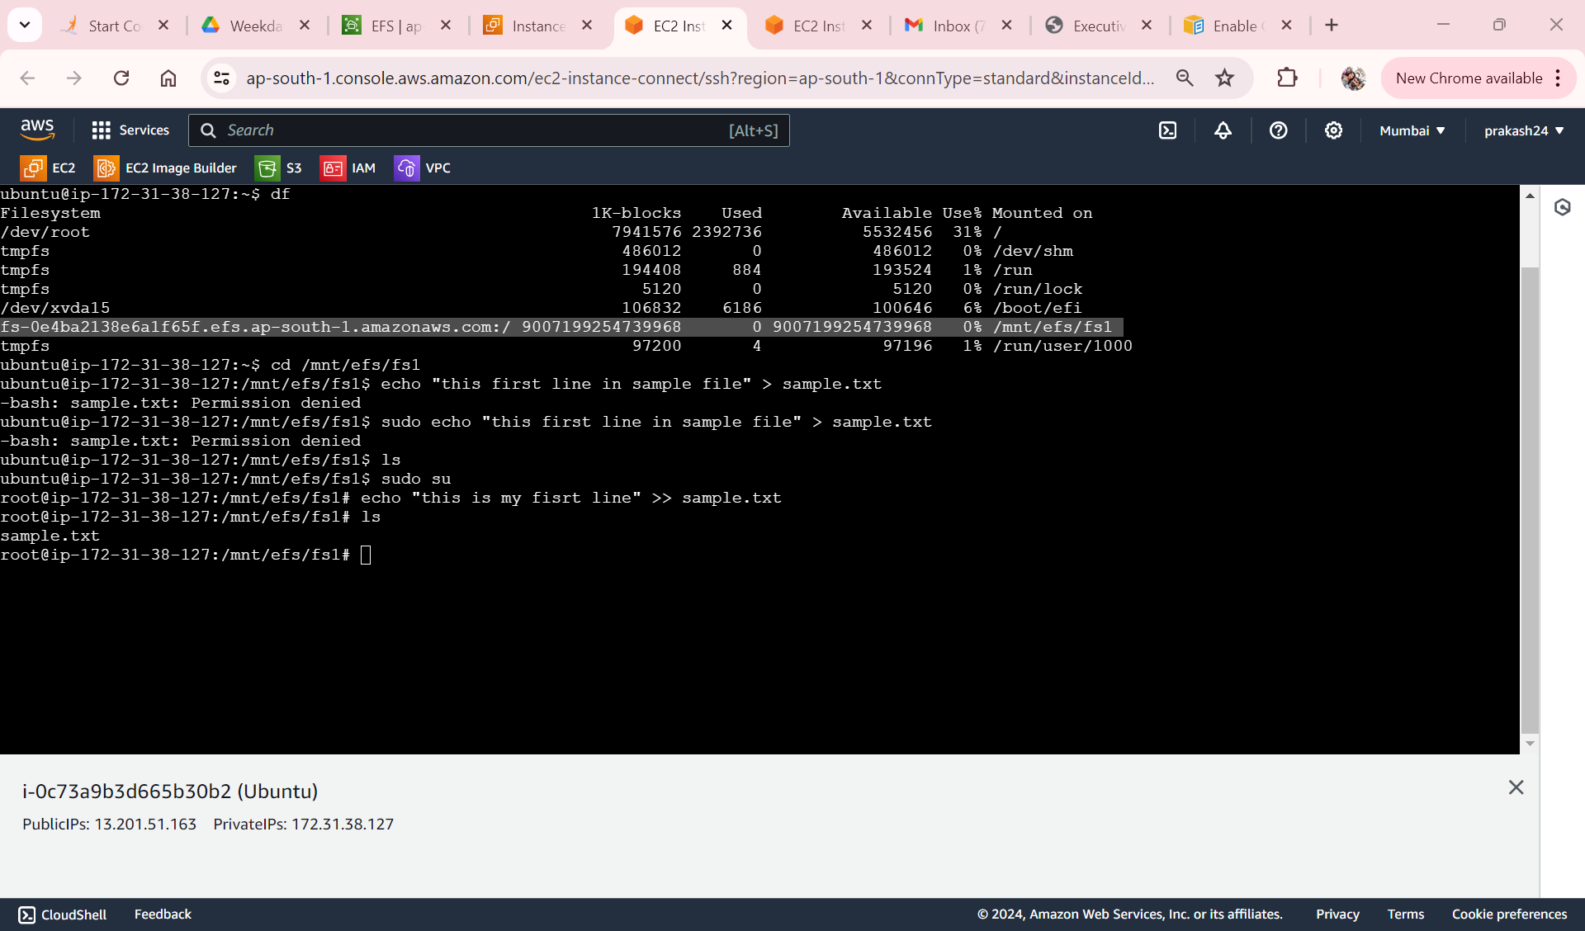
This is Ubuntu ec2 we can see EFS mounted

Slide 17
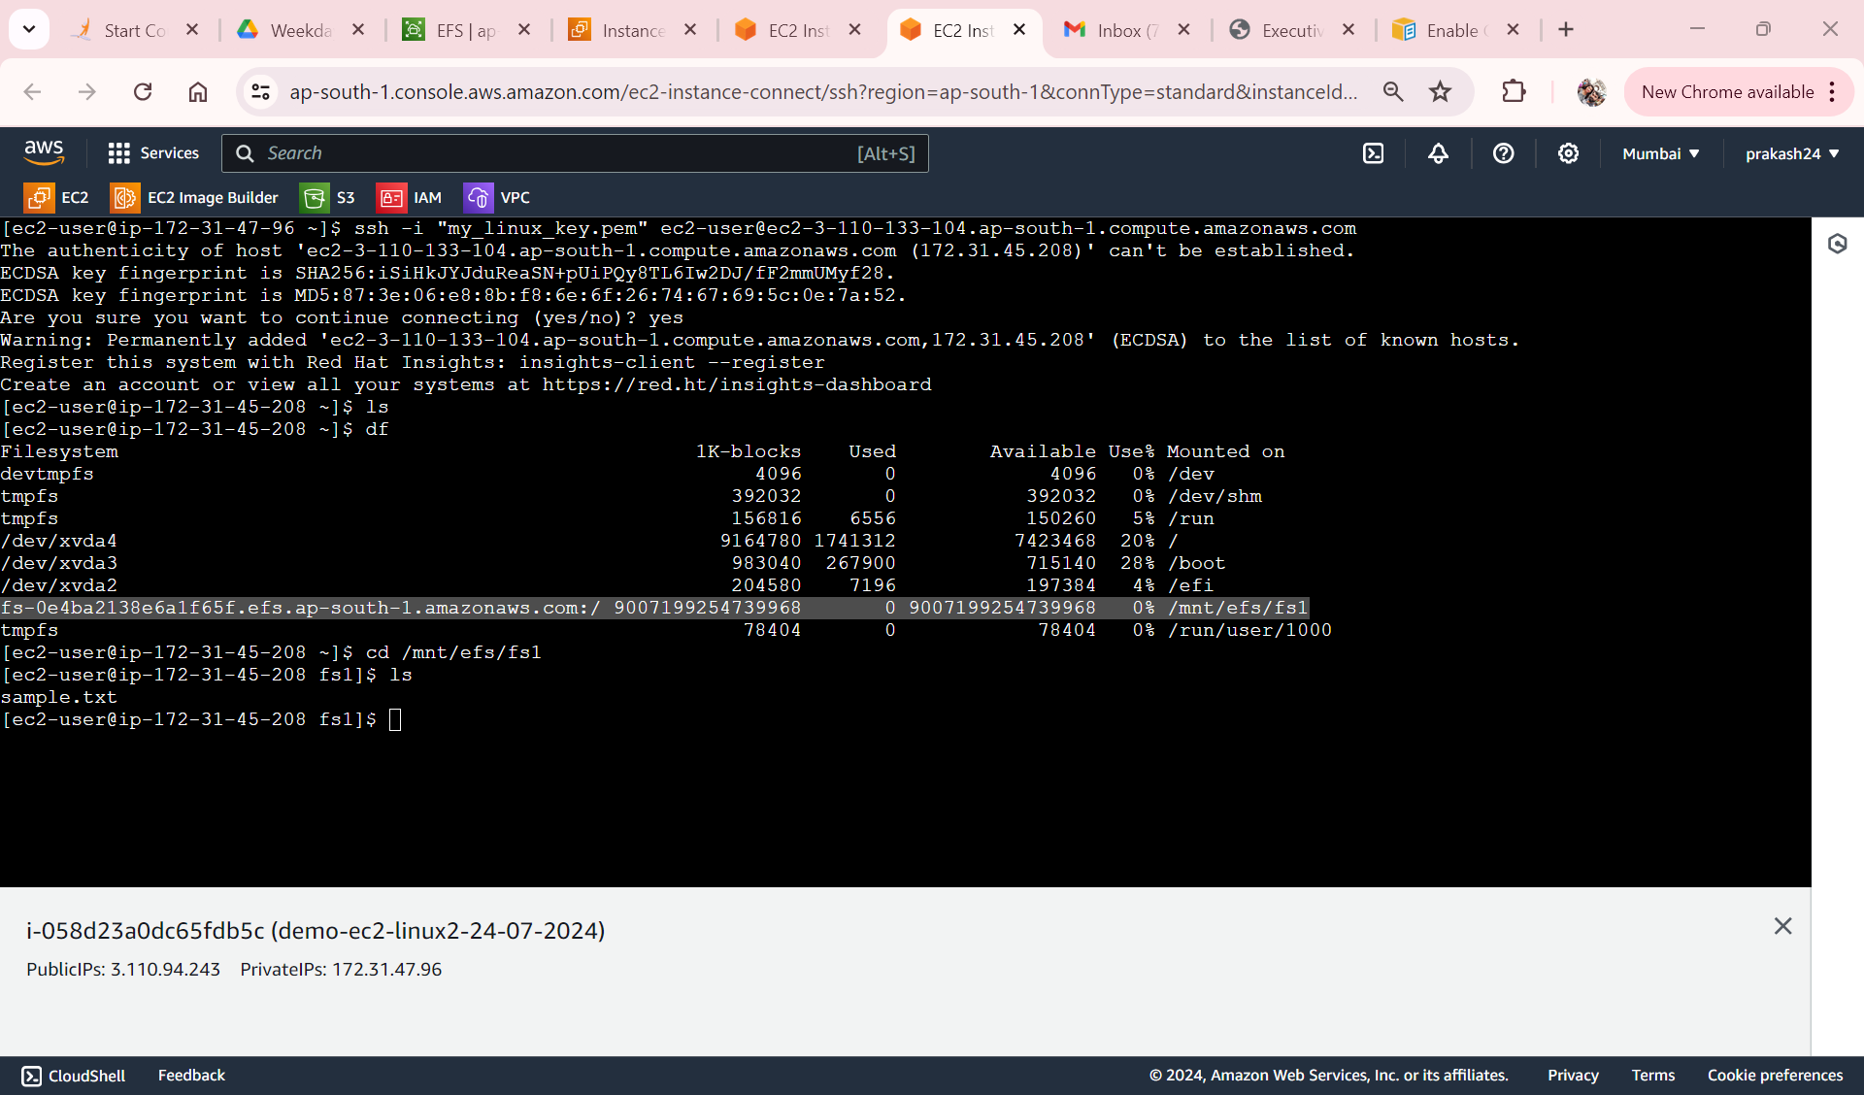
Connected RedHat machine via Linux 2 able to see EFS mount

Slide 18


Slide 19
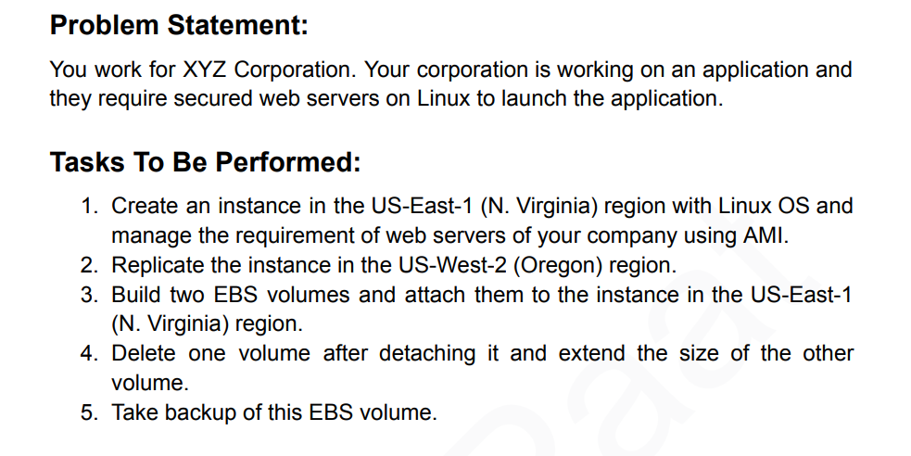

Slide 20
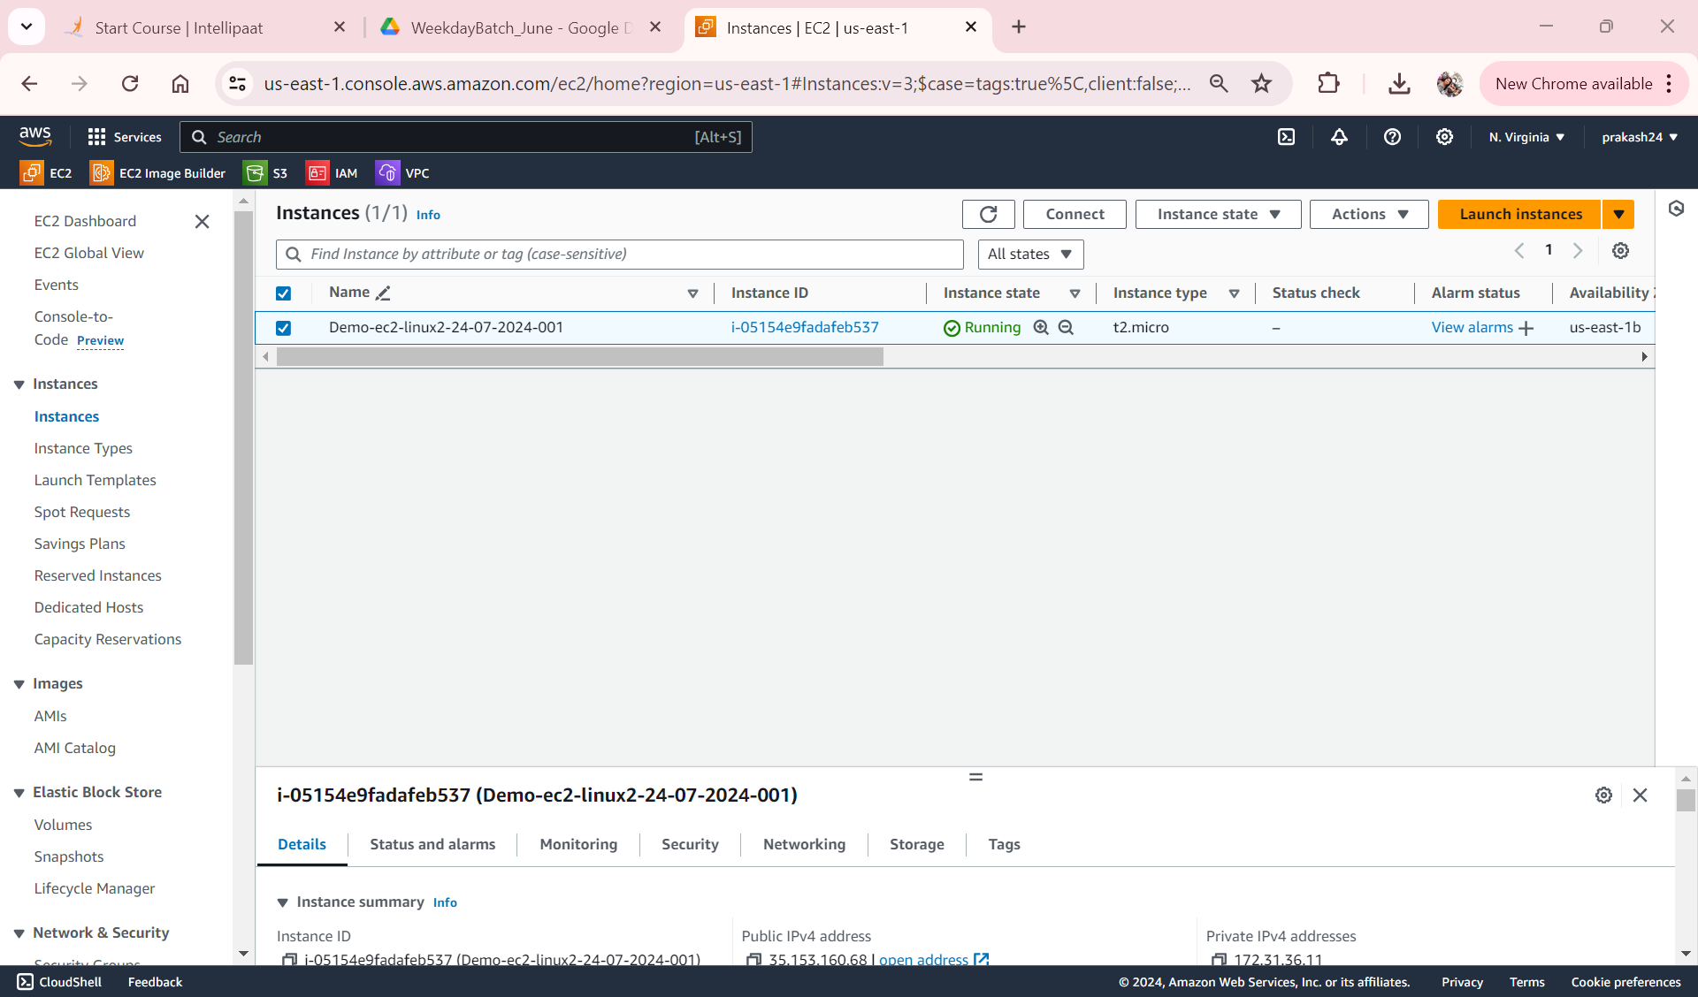
Instance Created in US-East-1

Slide 21
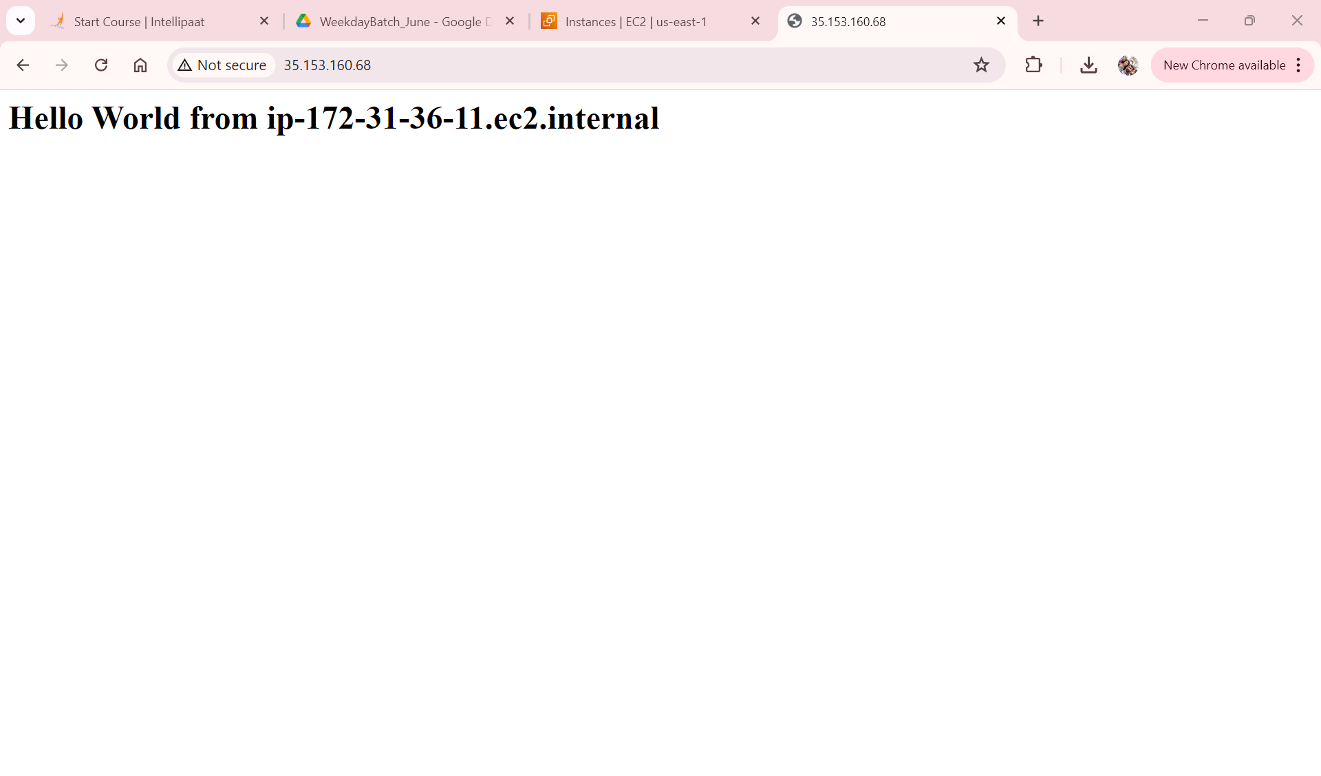
In Instance we have installed apace server to create AMI

Slide 22
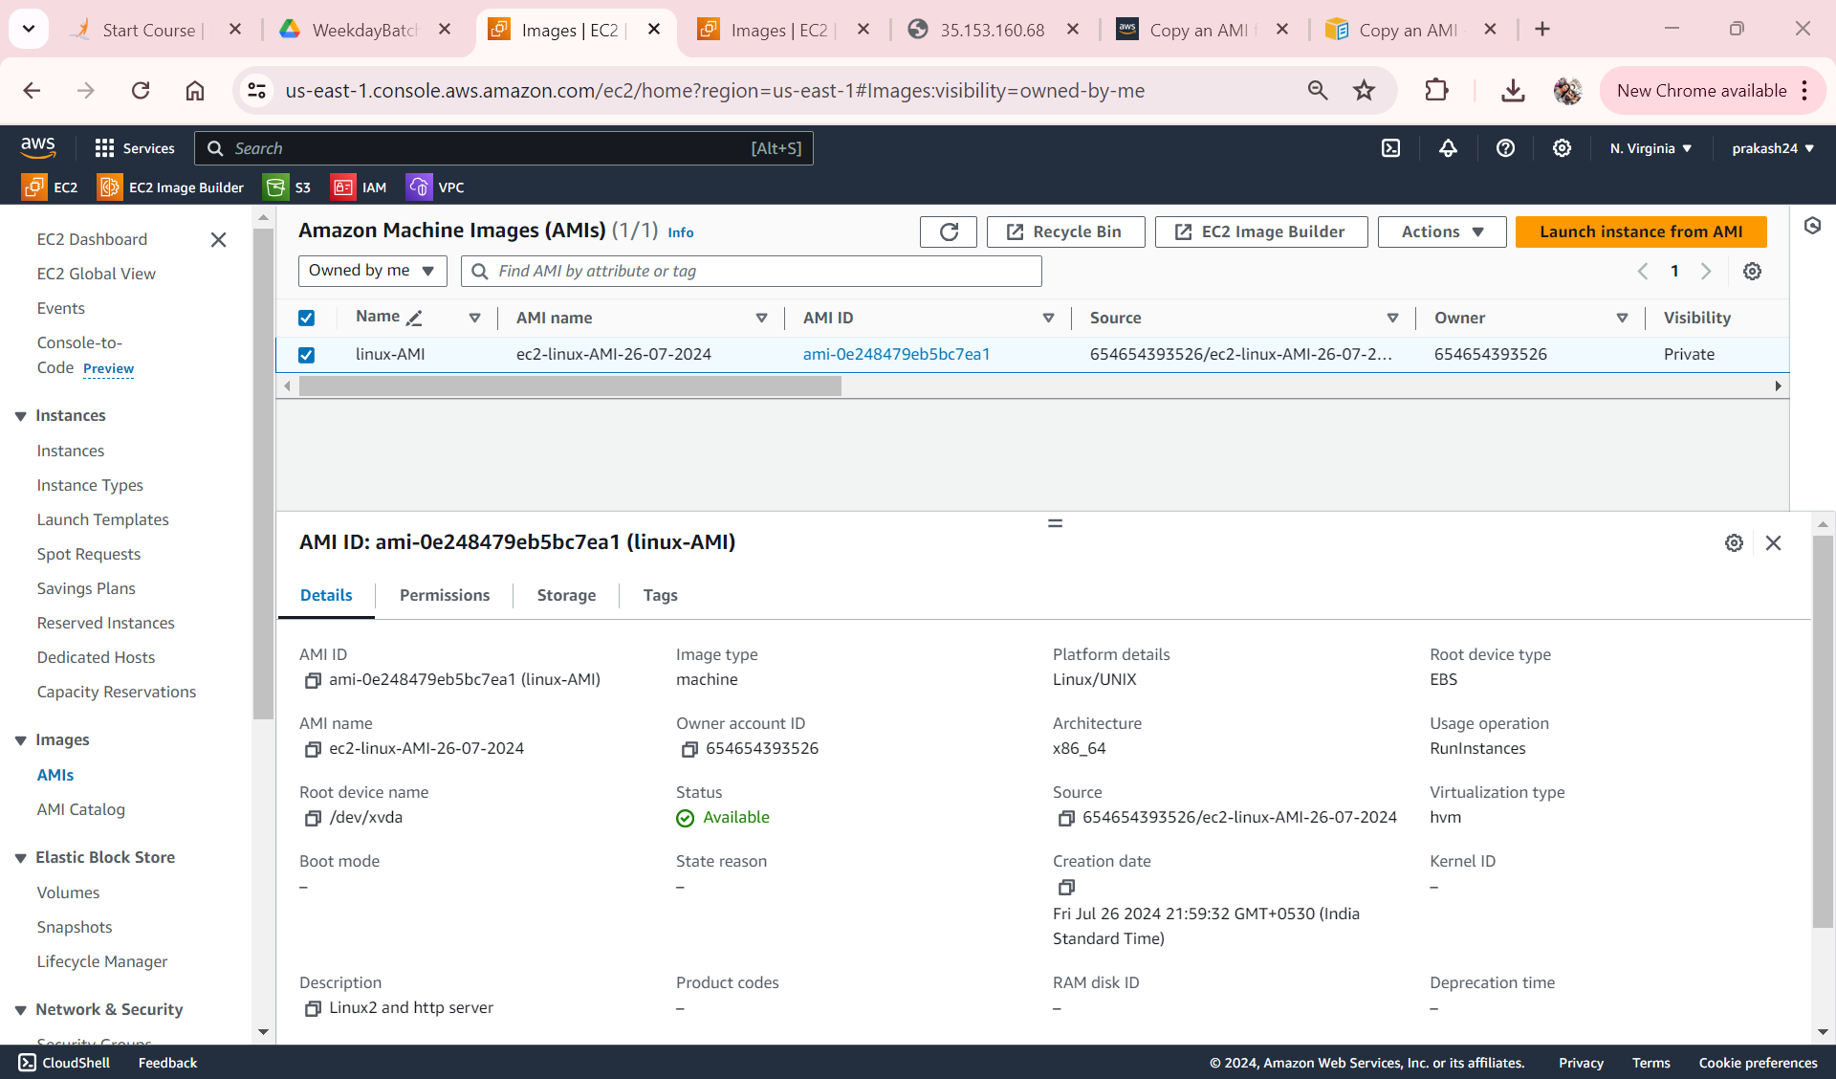
AMI Created from instance

Slide 23
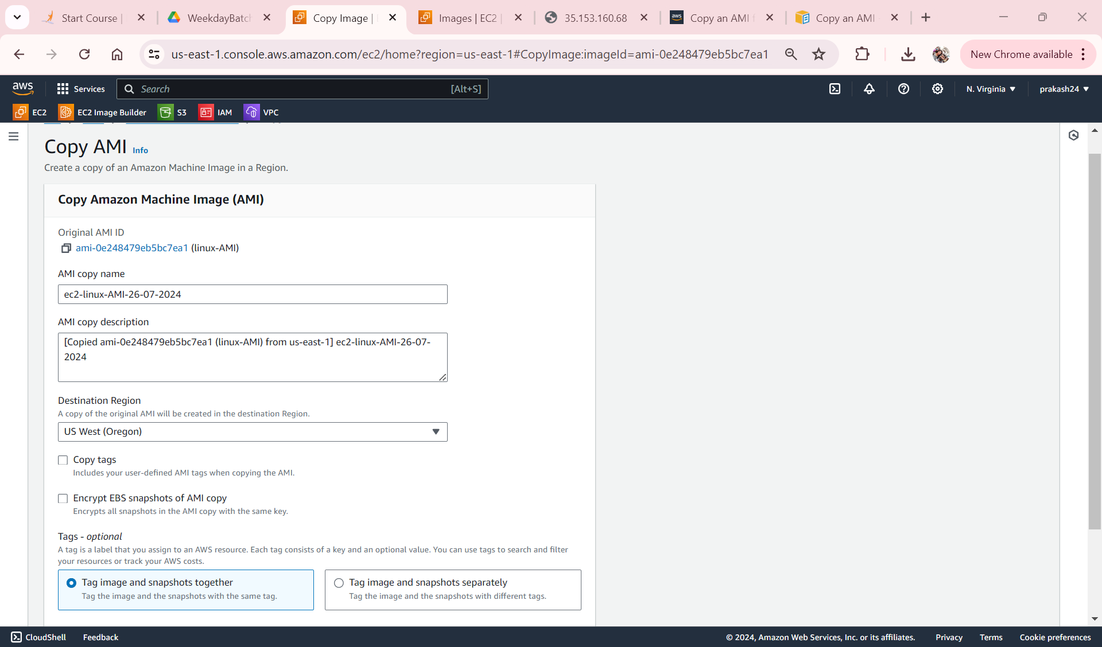
Copy AMI to US-East-1 to US-West-2

Slide 24
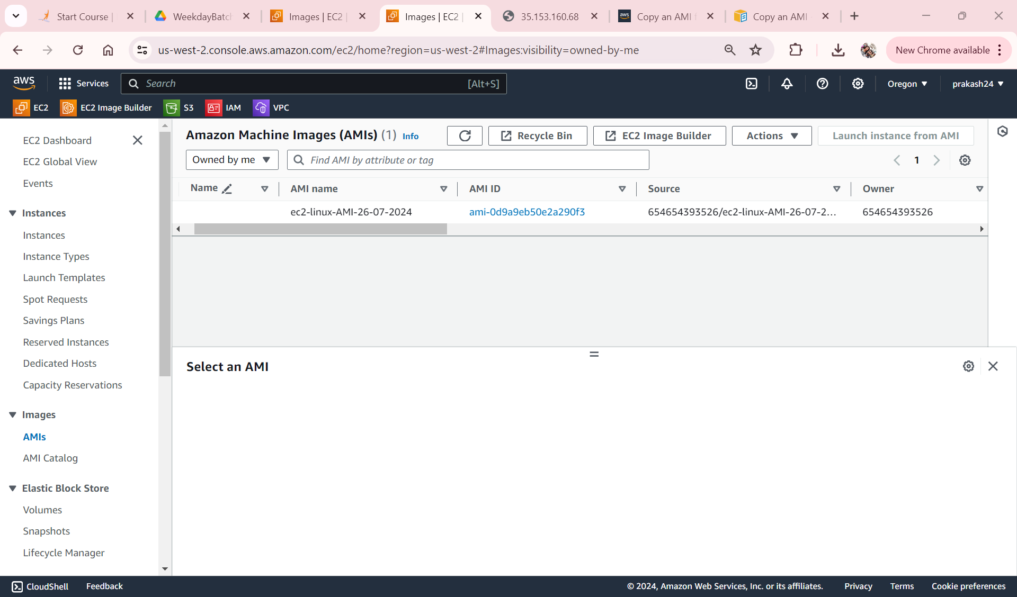
AMI is available US-West-2

Slide 25
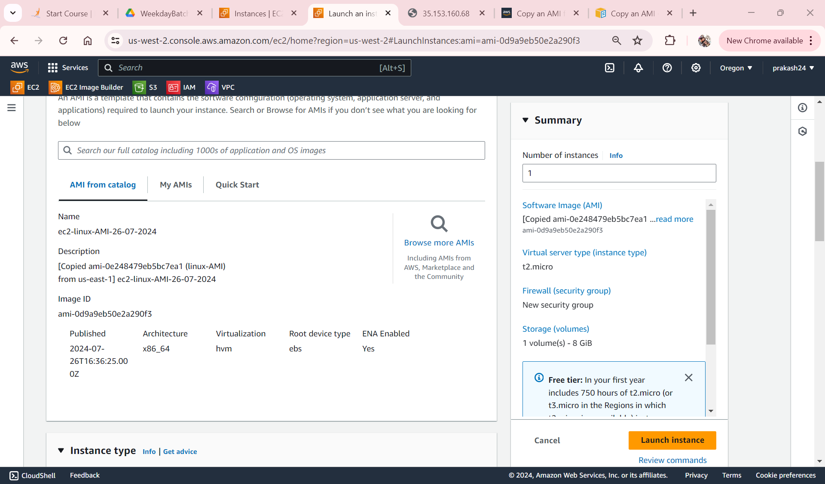
Launching Ec2 Instance using Linux AMI in US-West-2

Slide 26
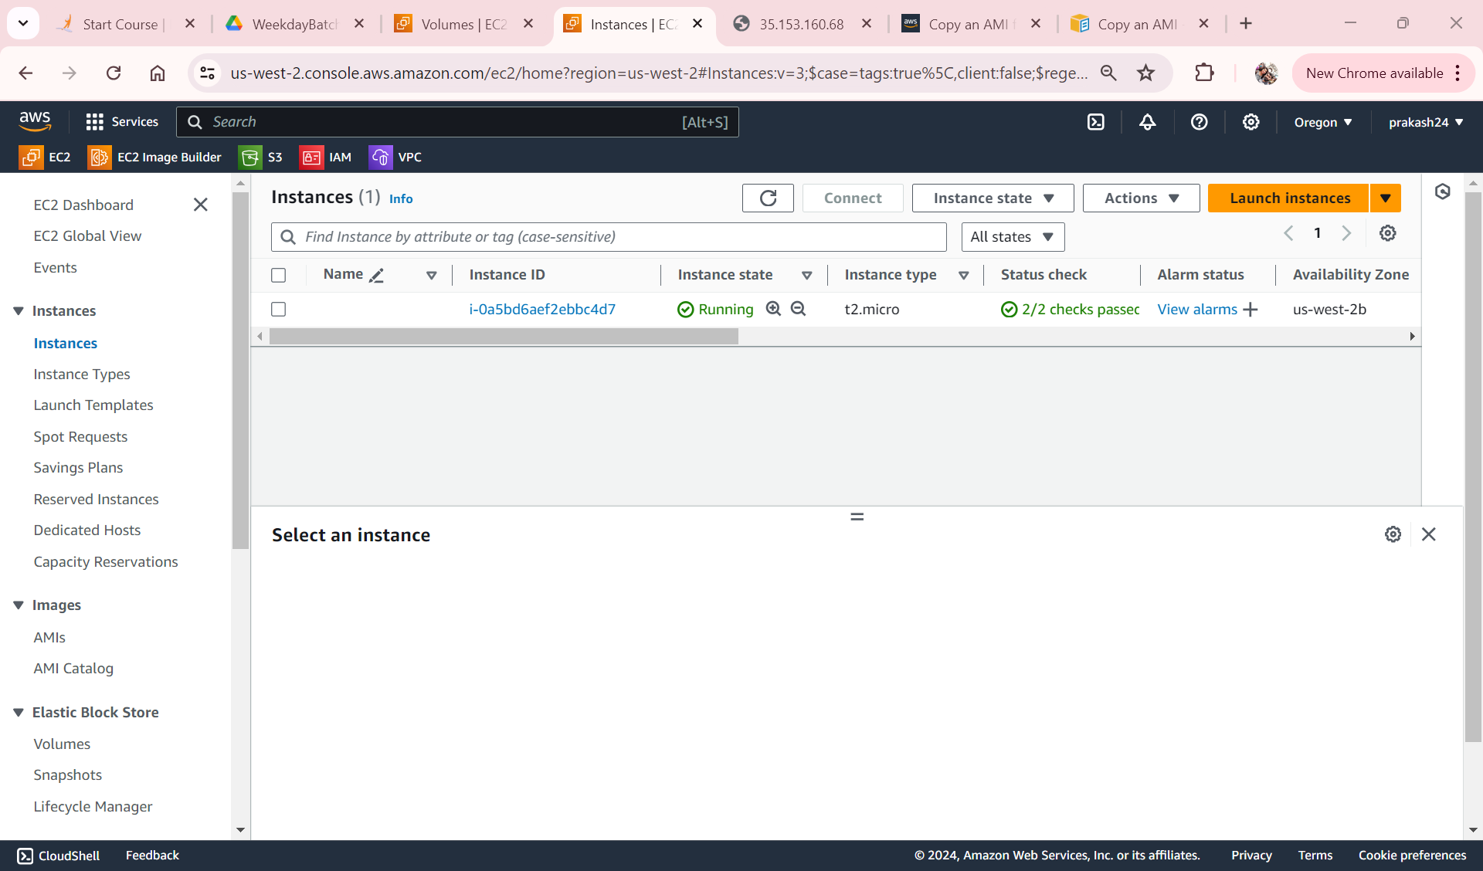
Ec2 Instance is Ready

Slide 27
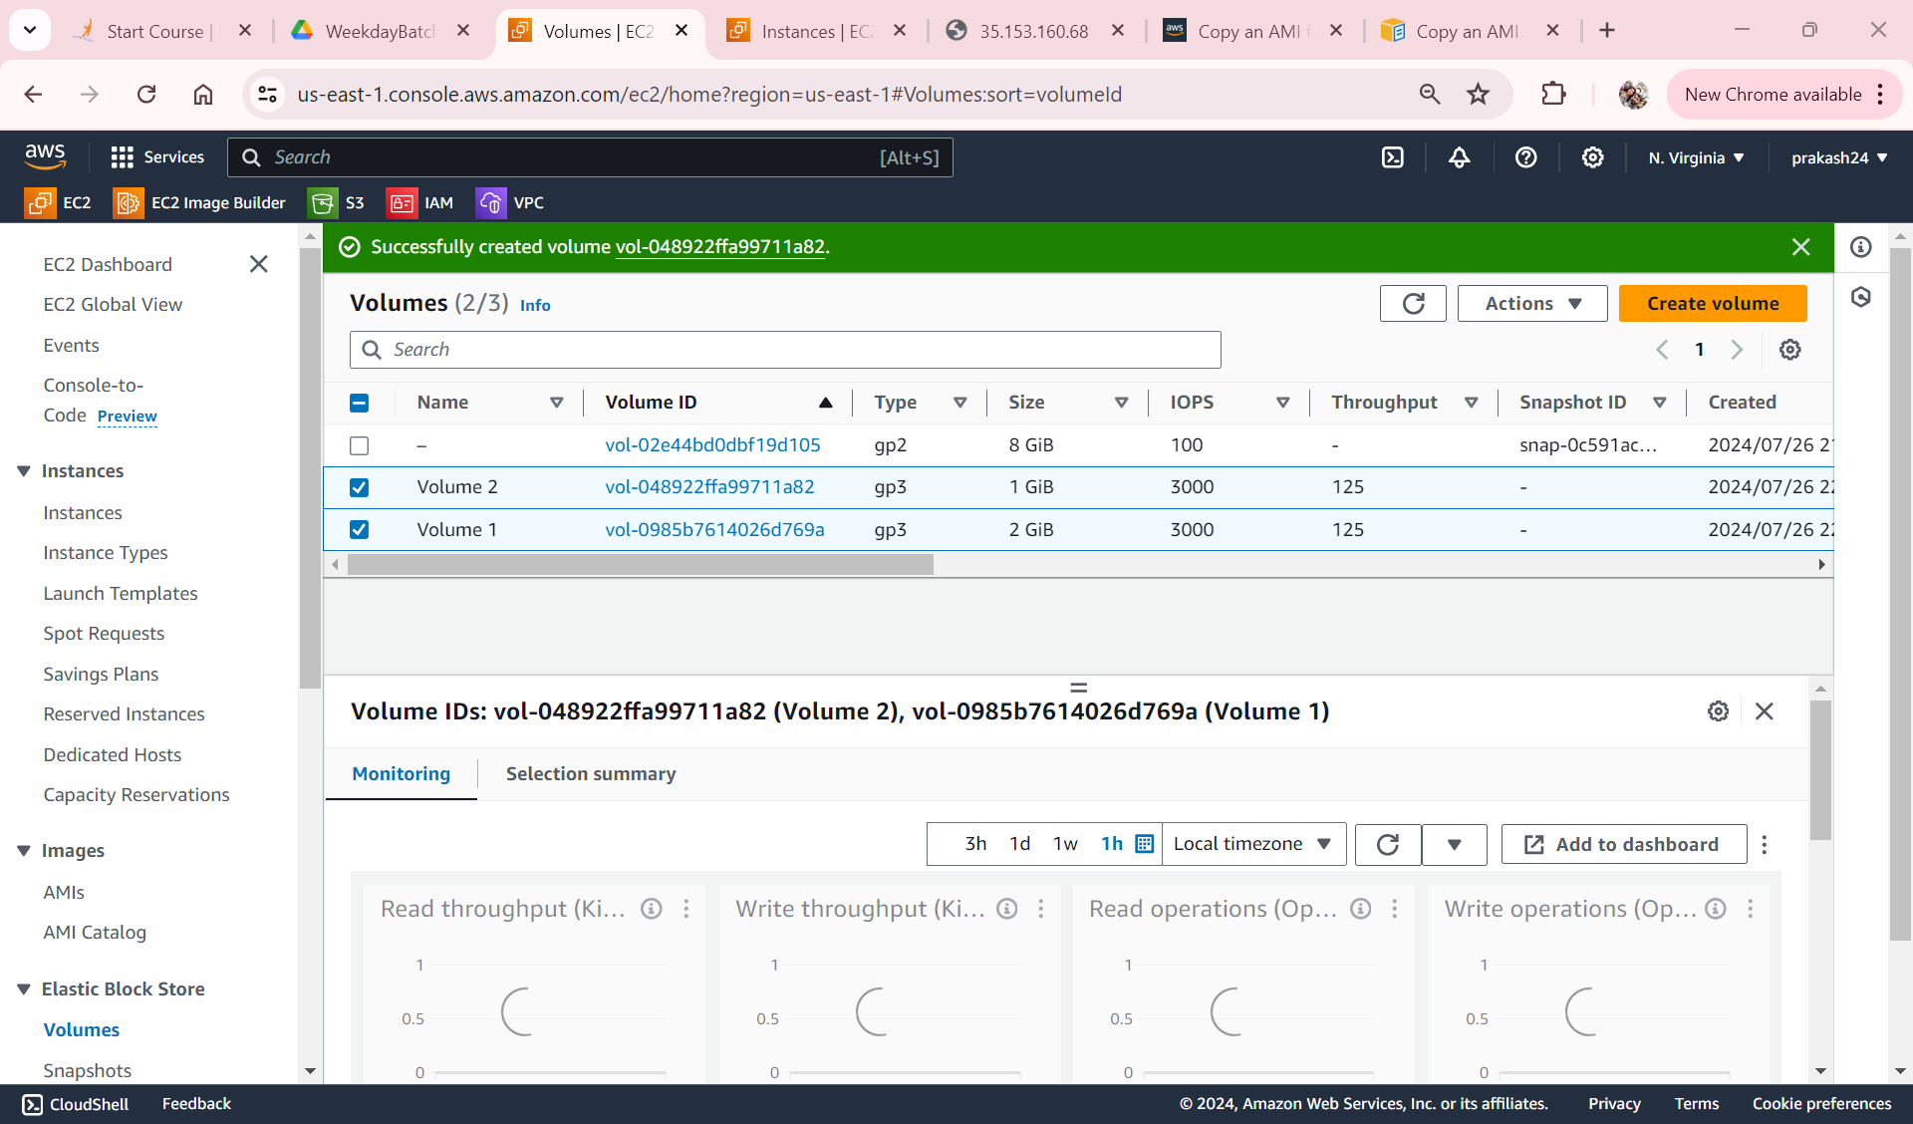
Created 2 EBS Volume

Slide 28
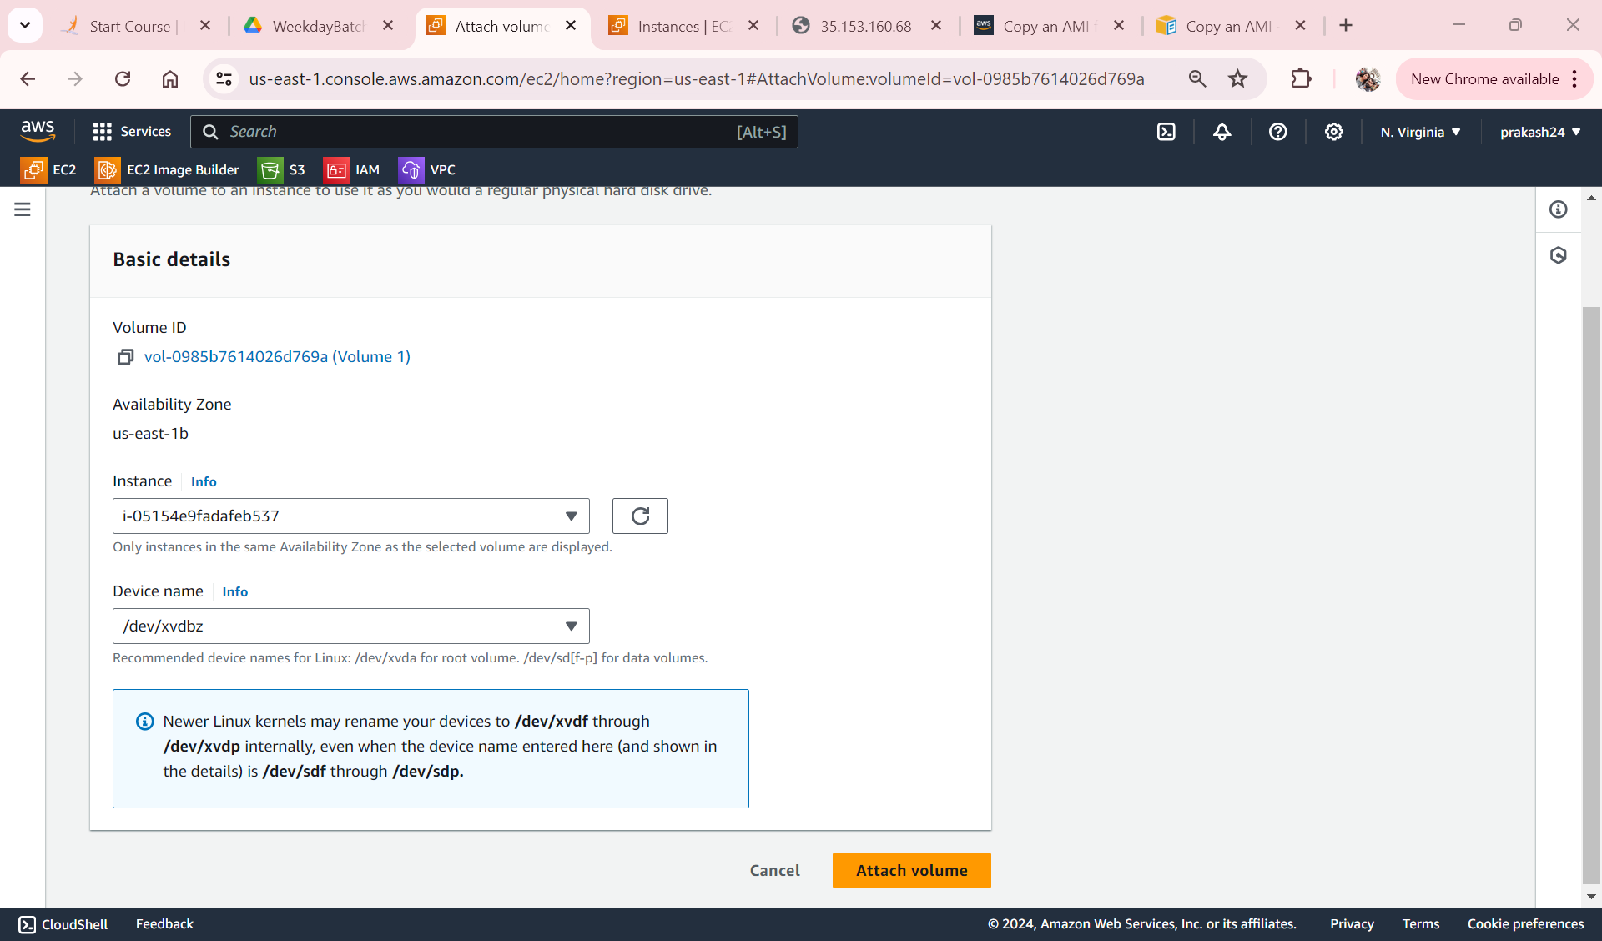
Attaching a volume 1

Slide 29

Attaching a volume 2

Slide 30
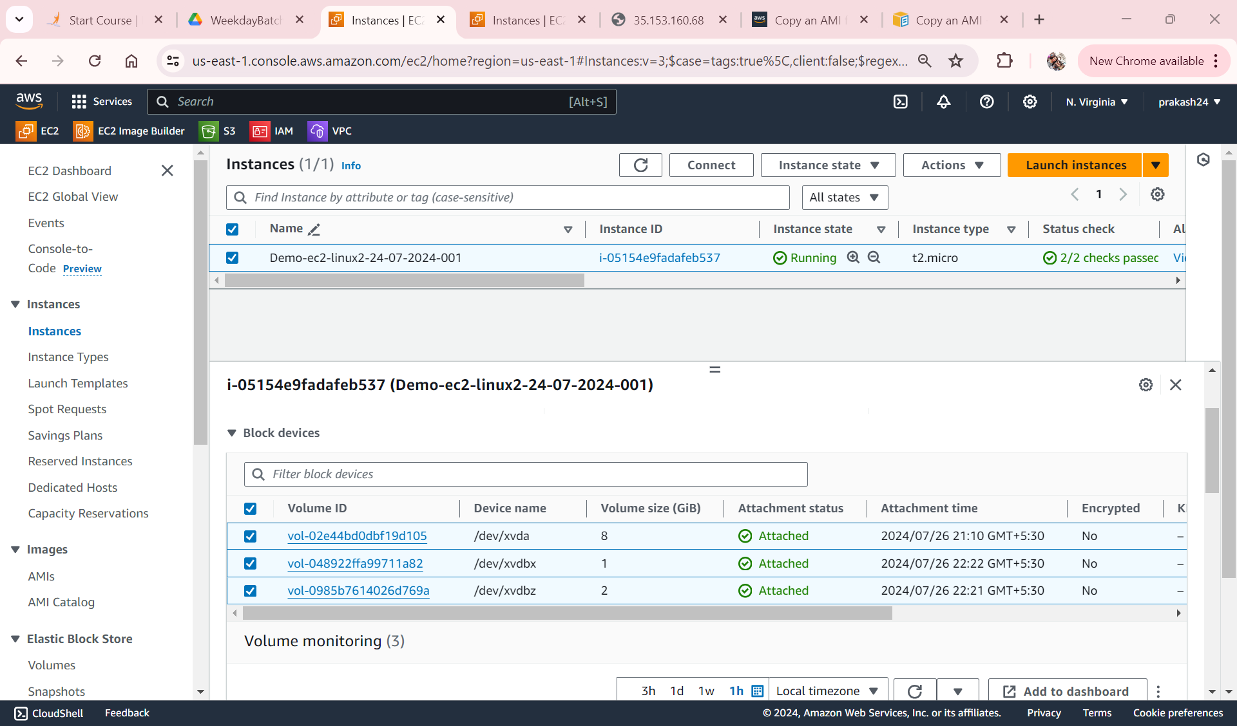
Both Volume attached in EC2 Instance

Slide 31
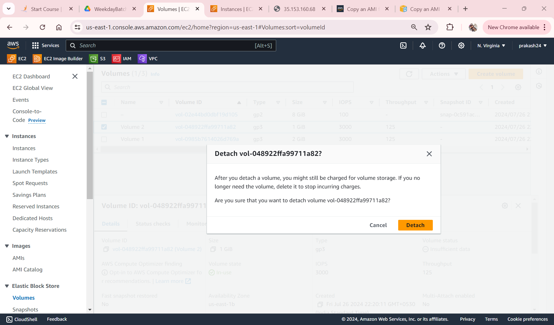
Detaching Volume1 from EC2 Instance

Slide 32
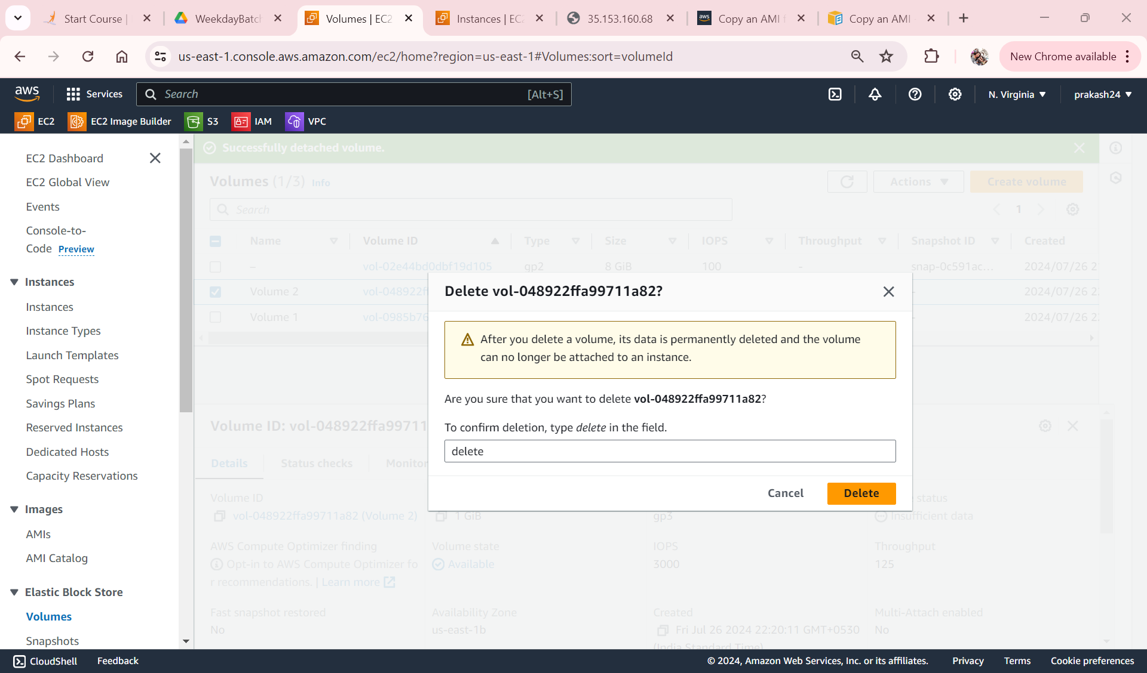
Deleting Volume1

Slide 33
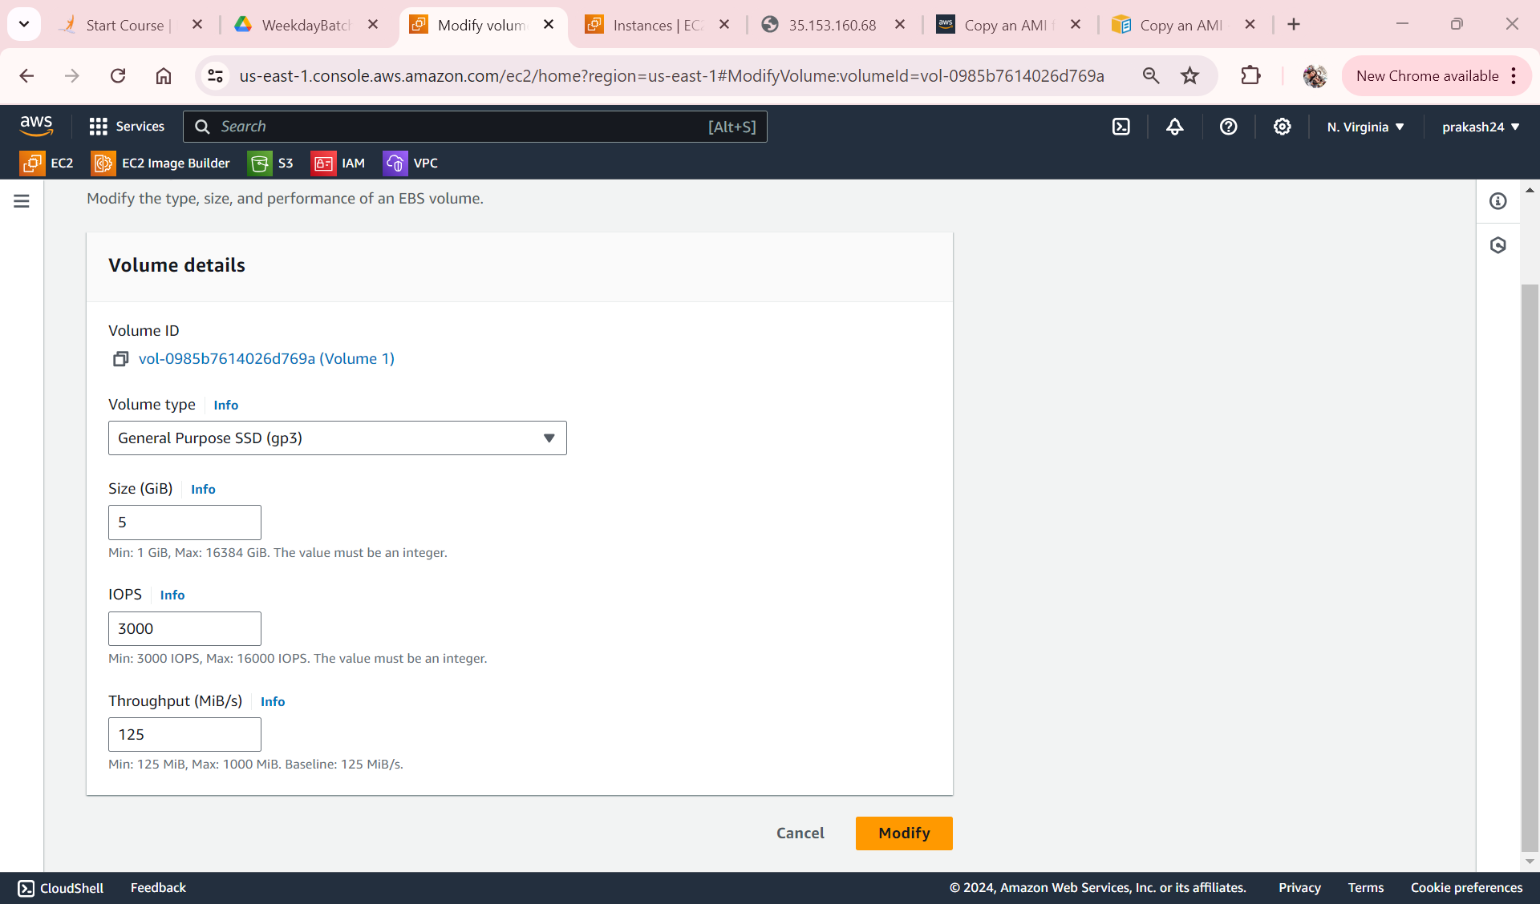
Resizing the Volume

Slide 34
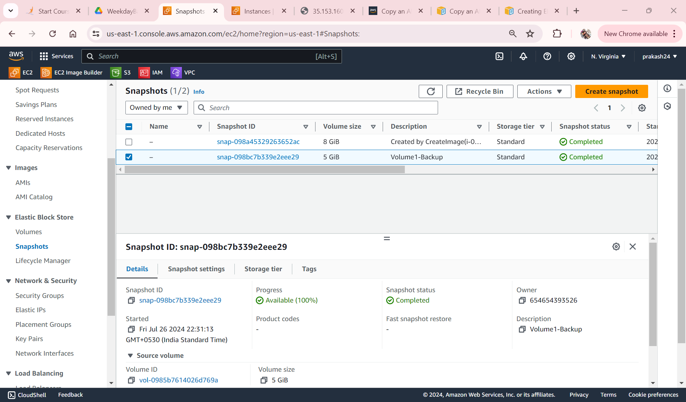
Created a Snapshot backup

Slide 35
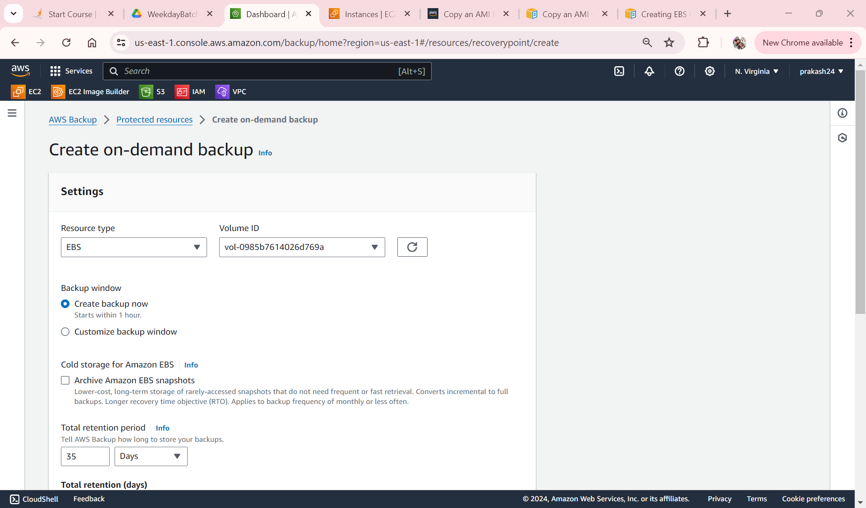
We can also use AWS Backup

